Slide 1
Welcome to School
Notes:
Kia Ora Koutou, my name is Alison Burge and I am a research nurse for Starship Community based at Greenlane in Auckland.
I have the privilege of presenting data from the Welcome to School Projects in Tamaki: a multi-cultural community with high social deprivation in East Central Auckland.
The Welcome to School study examined the health, education and social needs of children starting school in Tamaki.

Slide 2
Notes:
As part of the WTS study we asked parents what their hopes and dreams were for their children, most parents said they wanted their children to have a better life than they have had. Life had been difficult for a number of parents.

Slide 3
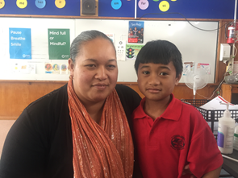
WTS Tamariki
Participants: 122
25% Māori
27% Tongan
19% Samoan
13% CI Māori
16% Other
Consent rate: 90%
Participation rate: ~50%
Notes:
The eligible population was children starting their first year of school in one of the decile 1 or 2 primary schools in the Manaiakalani Community of Learning. The study was conducted over a 12-month period encompassing four school terms: May 2nd 2016 to May 1st 2017. Children were excluded if they lived outside the Tāmaki area, or if they had previously attended another school.
All participants were between 5 years 2 months and 5 years 6 months of age. Ethnicity distribution: 25% Māori, 27% Tongan, 19% Samoan, 13% Cook Island Māori, and 16% New Zealand European/Other .
The consent rate was 90% and participation rate was approximately 50% of all new entrants starting school in the COL due to varying uptake of the project among participating schools.

Slide 4
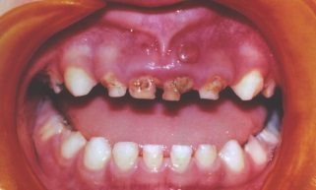
Notes:
The main results were
Low language skills: 1 in 4 were < 1st centile. This was measured using the CELF-P by a trained paediatric SLT
2/5 children were overweight or obese
Behaviour problems and not enough sleep
1 in 4 children needed a GA for rotten teeth
Significant hardship
33% needed glasses
2 in 5 children: poor impulse control

Slide 5
Deprivation and Language
50th c
Notes:
The results from the WTS study found a strong association between social disadvantage and core language scores. Association was with disadvantage not ethnicity or linguistic diversity.

Slide 6
Core Language Score
Victoria
WTS
50th c
Notes:
Several overseas studies have recognised a relationship between disadvantage and poor language learning, for example, the Australian Early Language in Victoria Study which demonstrated an effect of disadvantage on 5 year old.
Additionally, within this research it was noted that most of these children with significant language delays were not being seen by SLT services
The same pattern was seen here with only 4 children within the sample known to SLT services.
Profiles of language disadvantage has been suggested to involve stronger expressive language scores than receptive language scores. This pattern is also seen in the welcome to school data. This also mean that assessment involving measuring expressive vocab only is a poor indicator of overall language competence. This is also the opposite pattern we see for children speaking multiple languages.

Slide 7
WTS Conclusions
Multiple languages, rich culture
High aspirations
High developmental, behavioural and social needs
Not previously identified
Community norms
High levels of disadvantage
Intergenerational disadvantage
Our current health, education and social service delivery models are not meeting the needs of this community
Notes:
From the WTS study we concluded Tamaki has a rich culture with multiple languages, parents have high aspirations for their children and yet did not identify concerns. There was high developmental, behavioural and social need that had not been previously identified and had become norms for the community. The community has high levels of disadvantage.
Current services are not meeting the needs of this community

Slide 8
Welcome to School FU
Health
Communication
Verbal and nonverbal intelligence, working memory
Formal vision assessment
Formal ear check and hearing screen
Adverse Childhood Experiences (ACEs)
Interventions
Notes:
Due to the number of concerns identified in the original Welcome to School study a Follow Up study was done 18 months later to see how much progress these children had made and what further support might be needed for both child and whanau.
Health assessments included hearing , vision and ear checks and height and weight. A formal speech and language assessment was administered by a trained paediatric SLT. Verbal and nonverbal intelligence was measured using the KBIT. Due to the number of social concerns found in the Welcome to School study and the number of parents who said they wanted their child to have a better life than what they had had we included ACE screening in the WTS FU study.

Slide 9
WTS:FU
Notes:
Results from the follow up study included:
2 in 3 had low communication skills
Almost half with behavioural difficulties
Poor short term and working memory
Only 4 children had normal learning, behaviour and emotional control
3 in 5 were overweight or obese

Slide 10
Change in Language
11% 12.5%
50th c
WTS FU
Notes:
This slide shows the change in core language scores from the WTS to the WTS FU studies. 11% of children scored above the 50th centile in the WTS study and 12.5 for the WTS FU. As you can see there was no significant change between the WTS and WTS FU. Teachers had thought the low language scores at 5yrs were ESOL however this pattern shows one of language disadvantage instead.

Slide 11
Parental ACEs
Notes:
We asked parents about their own ACEs growing up. Of the 101 caregivers with ACES data, 30% had no ACES, 14% had 1 ACE, and 35% had more than 4 ACES.
In comparison to a US ACEs study, a much higher proportion of parents in Tamaki reported four or more ACEs before their 18th birthday
We also asked parents about their child’s ACEs. A similar pattern was seen: 30% of the children in our study had no ACES in comparison to 55% in the US,
And
16% had 3 or more compared to 10% in the US.

Slide 12
Notes:
Tamaki children and parents have high rates of Adverse Childhood Experiences.
This information is not known by the community and maybe linked to the adverse health and social outcomes in the community.
Screening for ACES was well accepted in the context of an established relationship and on-going follow up where required.
As the first NZ study to specifically examine this, it is highlighted a couple of key points
Firstly, the original ACEs questionnaires need consideration in the NZ context particularly considering broader systemic issues such as colonisation and intergenerational poverty.
Secondly,
ACE screening should not be done as a stand-alone screen but should be done within a Trauma Informed Approach. This acknowledges the impact of trauma through neuroscience and shifts the perspective from what’s wrong with you to what has happened to you.

Slide 13
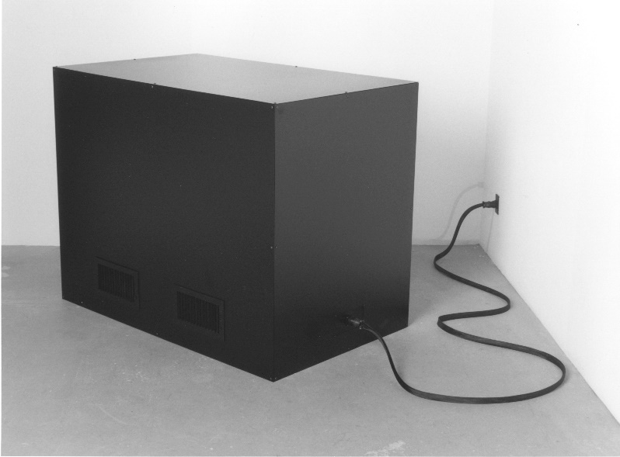
?Difficulty
What is preventing these whānau from engaging ???
The kids and whānau are complex :
Hungry, family disruption, sleep deprived
Emotional dysregulation, PTSD
A different way of learning, SLD
Hearing, visual impairment
ID
ADHD
Disordered attachment
FASD, meth-affected
Low language only, ESOL
TBI
Decreased opportunities, low expectations
Whānau AoD, MH, justice, poverty etc
DCD, ASD, CAPD, OSA etc etc.
Notes:
These are complex whanau
so we have to take a holistic neurodevelopmental approach :

Slide 14
Notes:
An ecological approach

Slide 15
WTS now we are 8
There are many children with unidentified issues who are at an academic disadvantage and ….this is not remediated early
Earlier identification is possible and perhaps this can improve immediate and/or longer term functioning??
Is routine early identification at school entry feasible ? And /or does this need to be an ongoing process…..
Notes:
Our questions now are ..

Slide 16
The next step: Neuro/ psychological Profile plus …
Formal speech and language assessment in the Welcome to School project (WTS) revealed 26% of children were less than the 1st centile on their core language score, with profiles reflecting predominantly language disadvantage rather than English speakers of another language (ESOL) or an underlying speech disorder.¹
A simple cognitive screen of verbal and nonverbal intelligence, the KBIT; suggested 30% of the children require further in-depth evaluation to exclude a significant developmental delay or intellectual disability.²
What is going on here ? Can we get services in place ?
2. Leversha A., Burge A, Nelson M, Kool B, Purdy S. Preliminary Analysis of the Welcome to School Followup Project. 2019.
1.Nelson M. Language in children starting school in Tamaki: The association of linguistic diversity and social disadvantage [Masters]: Auckland; 2018
Notes:
battery of tests
overall cognitive profile
Parental stress
strengths
behaviour and emotion
attention deficit vs trauma vs , dysregulation
memory
1.? There are many children with unidentified issues who are at an academic disadvantage and this is not addressed early
2.Earlier identification is possible and perhaps this can improve immediate and/or longer term fucntioning
3.Is Routine early identification at school entry feasible ? And or does this need to be an ongoing process

Slide 17
Can we Change the Trajectory?
Are we setting our kids up to fail?
Business as Usual is increasing inequity
Doing nothing is untenable
Data drive action (but data under-report)
Aims of the studies: twofold:
Individual data for clinical intervention
Population data for drive system change

Slide 18
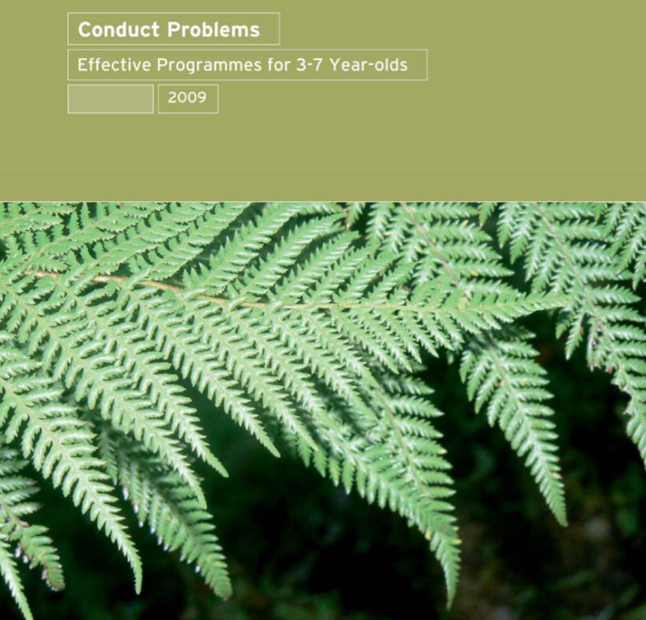
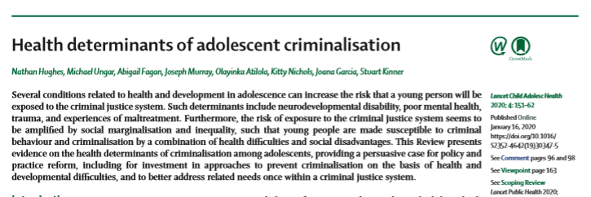

Slide 19
Co-investigators: Alison Leversha, Bridget Kool, Moira Nelson, Anna van Meygaarden, Suzanne Purdy, Russell Burt
Children and whānau
Teachers, SENCOs and Principals
Manaiakalani COL

Slide 20
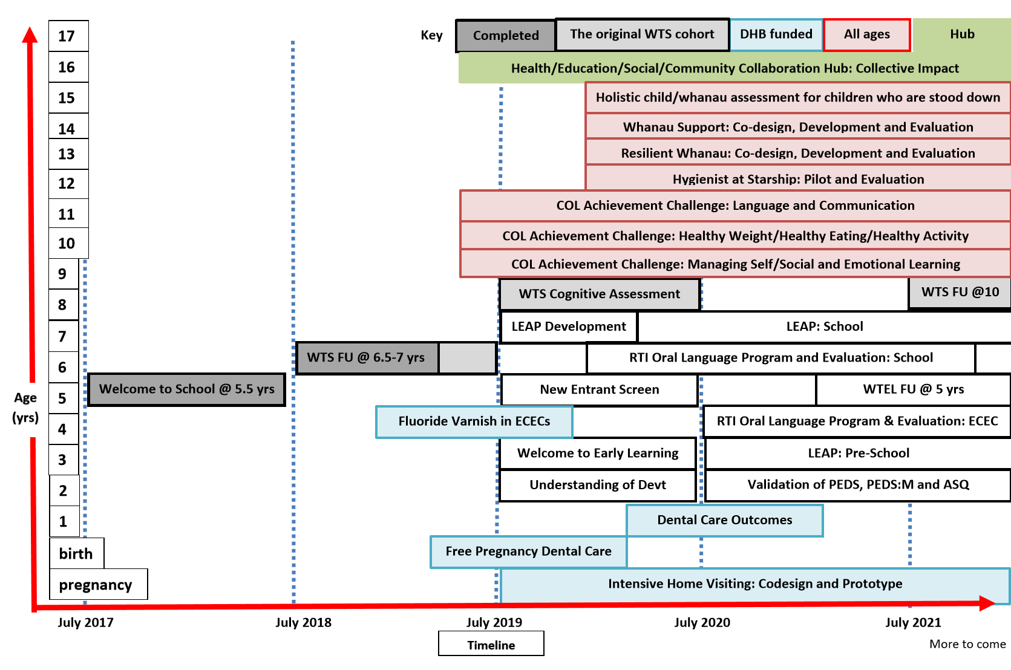

Slide 21
Whakatauki
E hara taku toa
I te toa taku tahi
Engari taku toa
He toa taki tini
Our strength is not ours alone,
but that of our community

