Slide 1
Digital interventions for youth with suicidal ideation or self-harm
CARN Conference
18 February 2020
Dr Sarah Hetrick
Associate Professor in Youth Mental Health
Department of Psychological Medicine, University of Auckland
s.hetrick@auckland.ac.nz
@SarahShetrick
Notes:
Tena koutou tena koutou tena koutou katoa
Ko Rimutaka te maunga
Ko te awaikairangi te awa
Ko Pakeha te iwi
Ko Hetrick e Raffills te whanau
Ko Sarah Hetrick tōku ingoa
In New Zealand we make sure that when we introduce ourselves we position ourselves in terms of where we are from – establishing relationships and trust.
My ancestors are mostly Scottish, I’m from Wellington – the capital of NZ but have mostly lived in Auckland, and also in Melbourne Australia, where I trained and worked at Orygen. So I bring greetings from New Zealand – Aotearoa – and from Australia.
I also want to acknowledge the land on which we are standing and, as we would in Australia and New Zealand, pay my respects to the elders past and present and those from first nations Inuit and Metis peoples who are present in the audience.
I also want to acknowledge those who are here today who have known someone, or in other ways been impacted by someone who has died by suicide. Please take care, and seek support if you need it.

Slide 2
Objectives
1. Understand the importance of a youth perspective and what it can teach us
2. Examples of digital interventions for youth with suicidal ideation or self-harm
3. Signal future directions in evidence based strategies
Notes:
Advocate for and implement youth co-design when developing and implementing services and interventions for young people (understand the importance of involving young people to understand needs and solutions; understand that young people hold the solutions within themselves)
Advocate for and apply evidence based strategies (update of recent developments)
Apply a critical lens (understand there are other ways of viewing what is in front of you – mine is only one world view and may not be shared by my client)

Slide 3
Young People

Slide 4
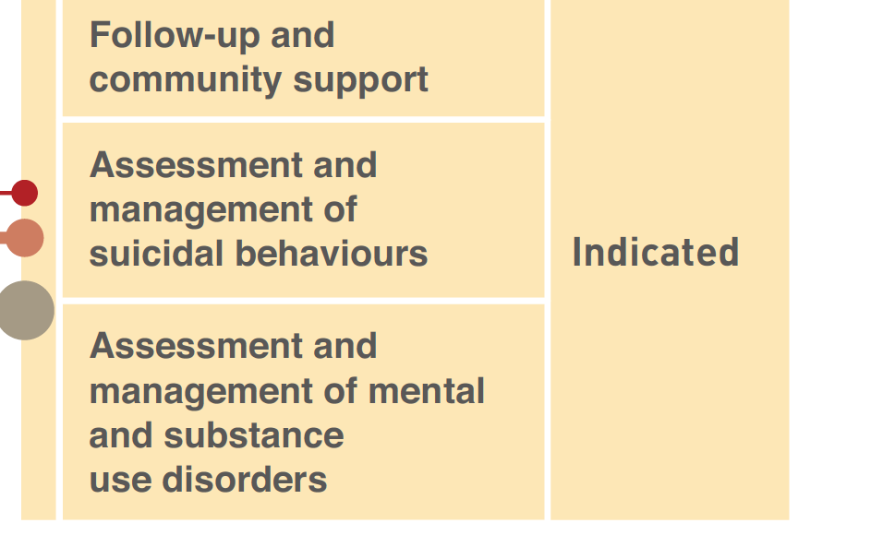
Multilevel Intervention
Notes:
WHO ‘Preventing Suicide’ Report.
Self-harm refers to intentional self-injury (e.g., self-cutting) or self-poisoning (e.g., consuming substances not intended for human consumption and/or medications in
excess of the recommended therapeutic dosage), irrespective of motivation of degree of suicide intent.
Hawton K, Harriss L, Hall S, Simkin S, Bale E, Bond A (2003) Deliberate self-harm in Oxford, 1990–2000: a time of change in patient characteristics. Psychol Med 33:987–995

Slide 5
Risk factors: PARS
Modifiable factors | Population Attributable Risk
BPD | 42.4%
Any PD | 16.3%
Mood disorder | 42.2%
Severity of hopelessness | OR 2.95 (CI 1.74-5.01)
Suicidal ideation | OR 2.01 (CI 1.43-2.81)
Previous sexual abuse | 12.8%
No history of self-harm and/or attempted suicide prior to the index hospital presentation was associated with a reduced risk of self-harm repetition
Notes:
PARS: estimate the potential impact of these factors on repetition at a population level (proportion of cases that can be attributed to each risk factor)
17 studies.
NOTES: Population Attributable Risk Fractions: calculated from the OR and estimate of the population prevalence of that factor derived from the control group. You can’t calculate PARS for factors measured on a continuous scale, as the proportion exposed at each level of the scale could not be estimated from the data available.

Slide 7
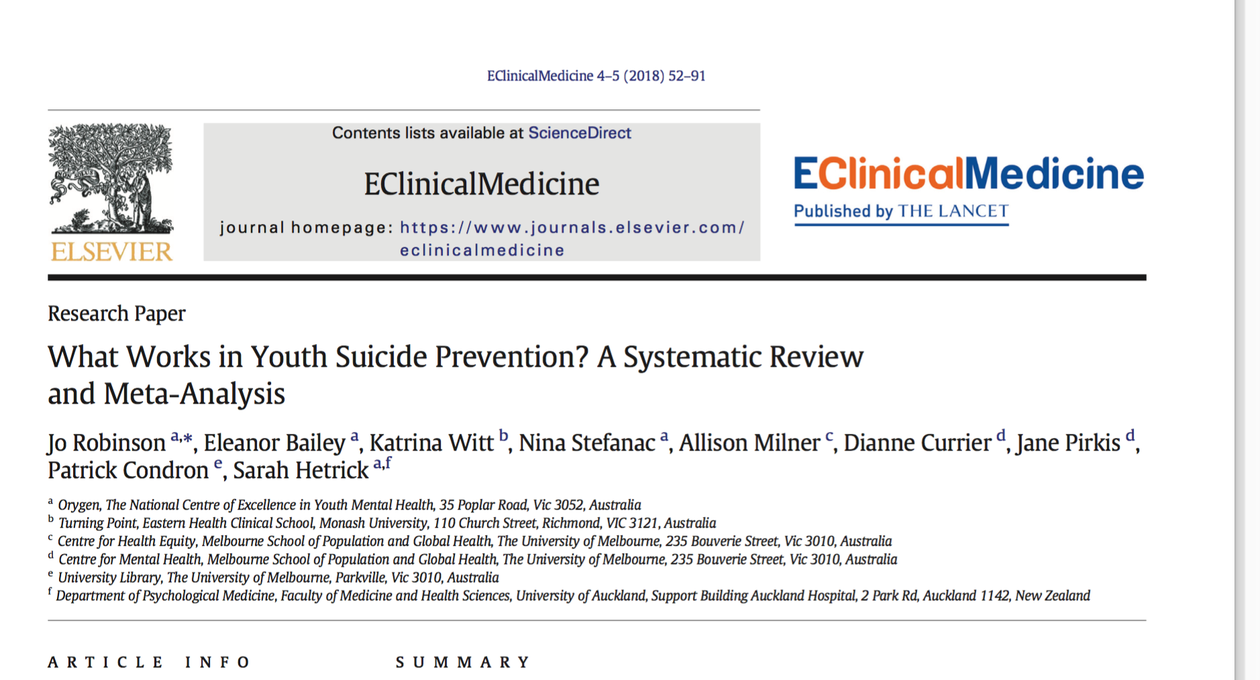

Slide 8
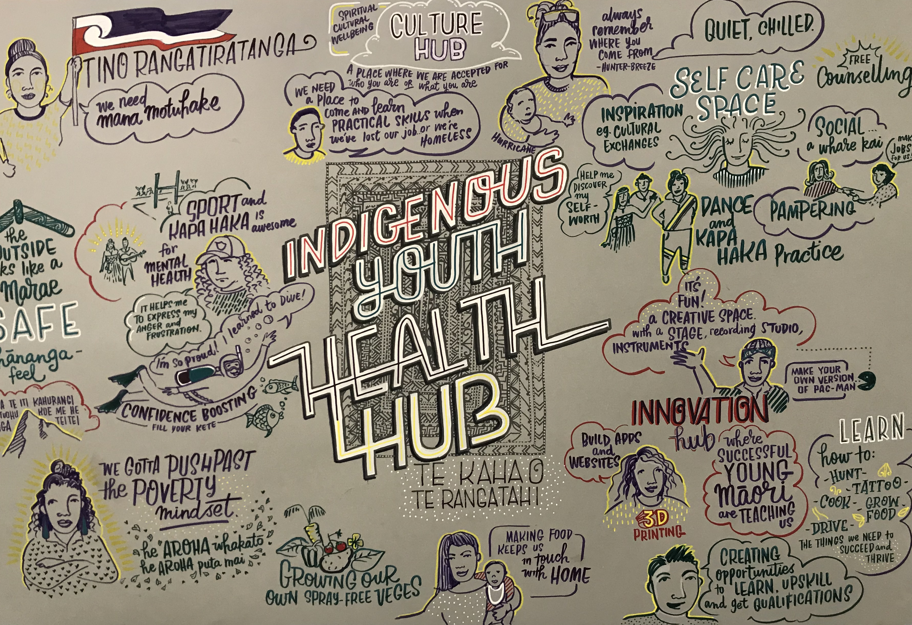
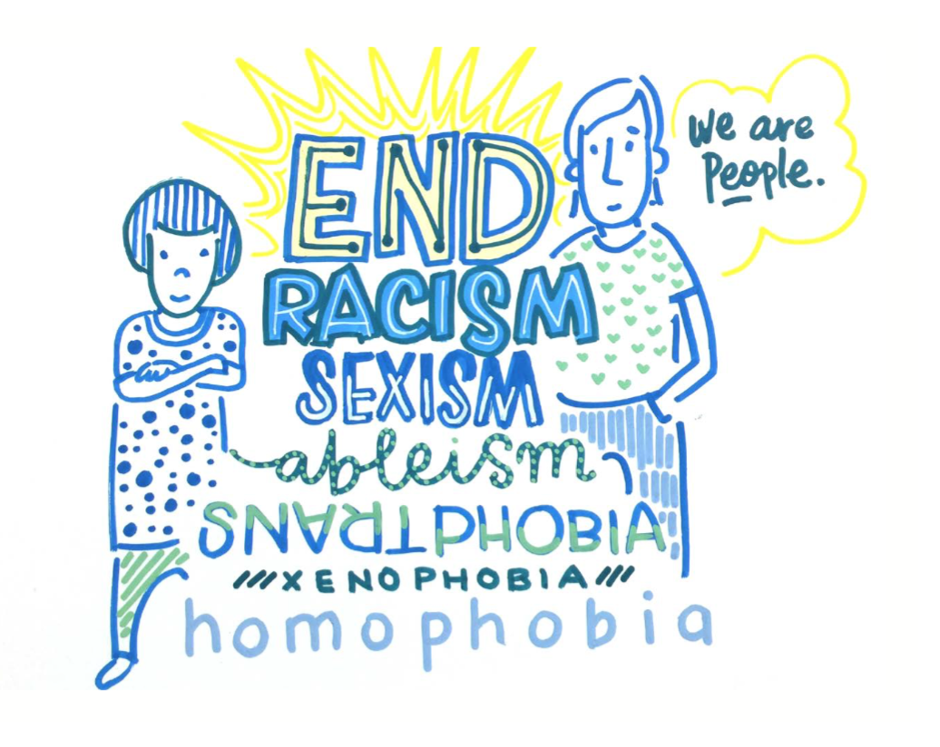
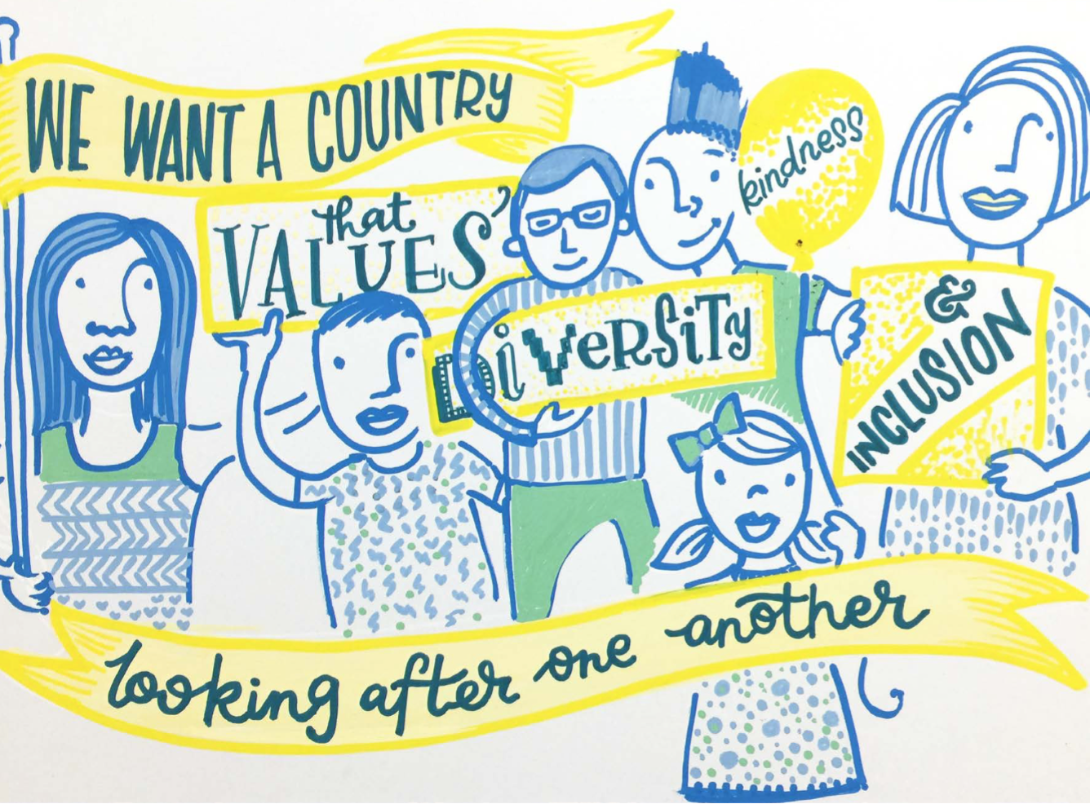
So we know what the evidence says...
What do young people say?

Slide 9
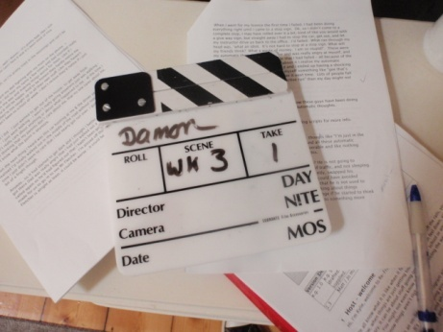
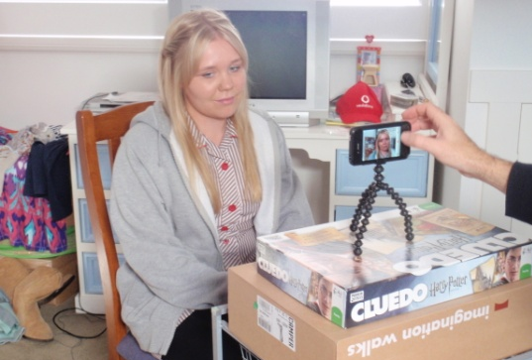
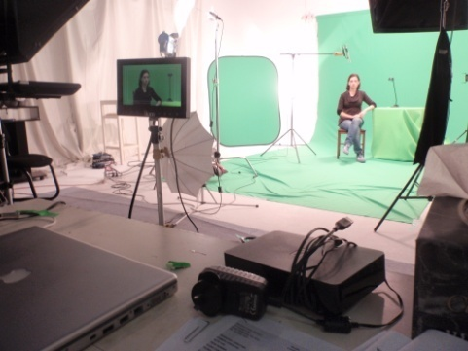
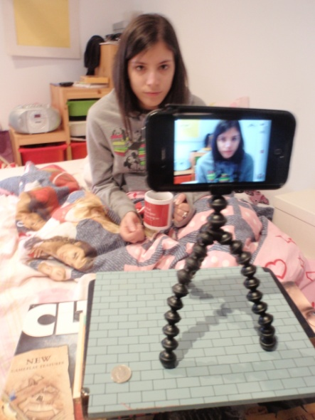
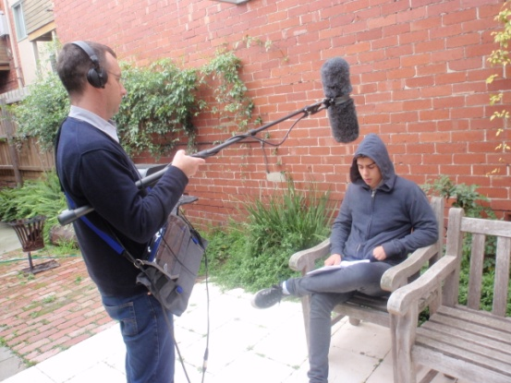
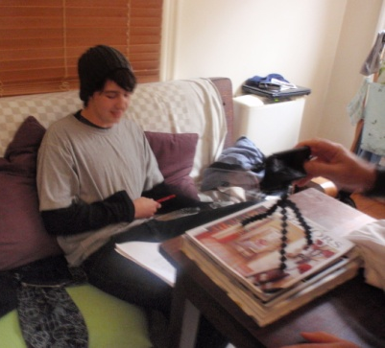
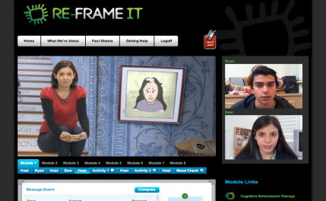
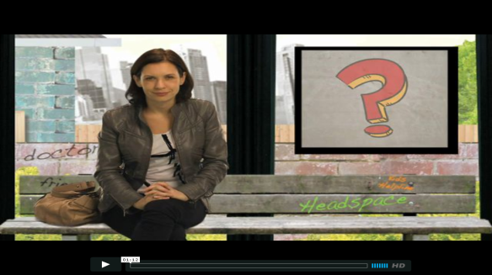
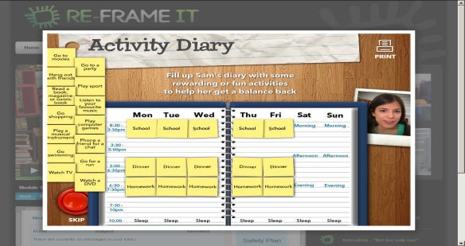
Managing Youth Self Harm and Suicide II
Reframe-IT
Module | Content
Week 1 | Introduction, engagement & problem identification
Week 2 | Emotional recognition & distress tolerance
Week 3 | Identification of negative automatic thinking
Week 4 | Behavioural activation - help-seeking
Week 5 | Behavioural activation - activity scheduling & relaxation
Week 6 | Problem solving
Week 7 | Cognitive restructuring
Week 8 | Wrap up & review

Slide 10
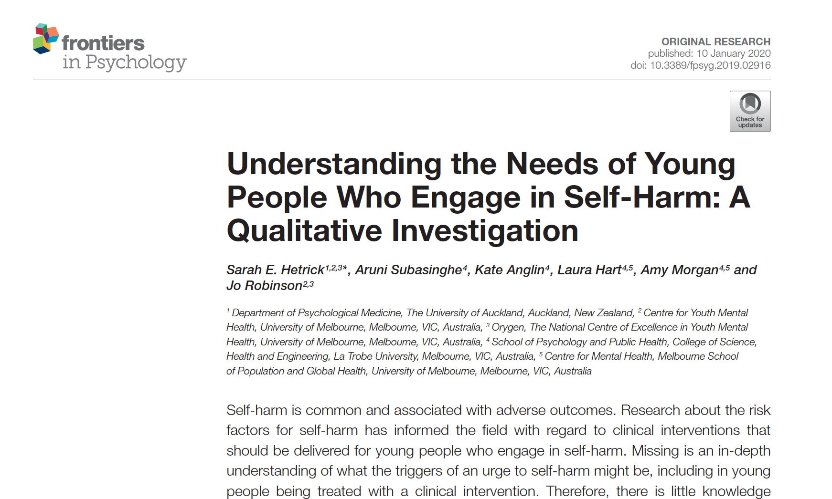
Triggers
Relationship difficulties/conflict
Distressing emotions (burden, shame, anger, overwhelmed)
Isolation
Exposure to self-harm
Social comparison
School/work difficulties
What might help
Idiosyncratic (depends on: level and cause of distress, interests, environment, skill set)
Distraction (to suit intensity of distress)
Connectedness (but barriers to connecting)
Change the environment (public is safer, remove self from trigger, activity)
Mimicking strategies (unhelpful/invalidating; useful in public)

Slide 11
What are young people saying?
Tune In
Young People:
15-18 years old
6 Interviews
“there is a lack of a feeling of connectedness with other people, which may or may not include a general feeling of being lonely or being isolated from everyone”
“I had lots of friends who are pretty unsupportive and like they would all self harm and I thought it was cool”
“I’m not gonna lie, social media society…you have an expectation to reply every five seconds, you have an expectation to look a certain way, you have an expectation to like a post that everyone else has liked”
“We start to fall in love and stuff like that and then it’s a big shock when all of a sudden that person doesn’t love you or something. I’ve actually noticed a lot more guys put more of their heart into it than girls do…you just think oh well it’s not gonna work for me, there’s no point in living, and then it’s over”

Slide 12
Tune In App Development
Young People
15-18 years old
6 Interviews
x6 YP- focus group
X15 YP- Polyfest group
Mixed ethnicities
Mixed socioeconomic backgrounds
Clinicians:
x12 clinicians
Mixed professional background
Mixed ages/ethnic backgrounds

Slide 13
A positive approach to behavior change
Capability
Intention; goal setting
Opportunity
Autonomy
Motivation
Rewards

Slide 14
Vision
To empower young people to track & achieve positive change, through a personalised digital experience, connecting to a support network.

Slide 15
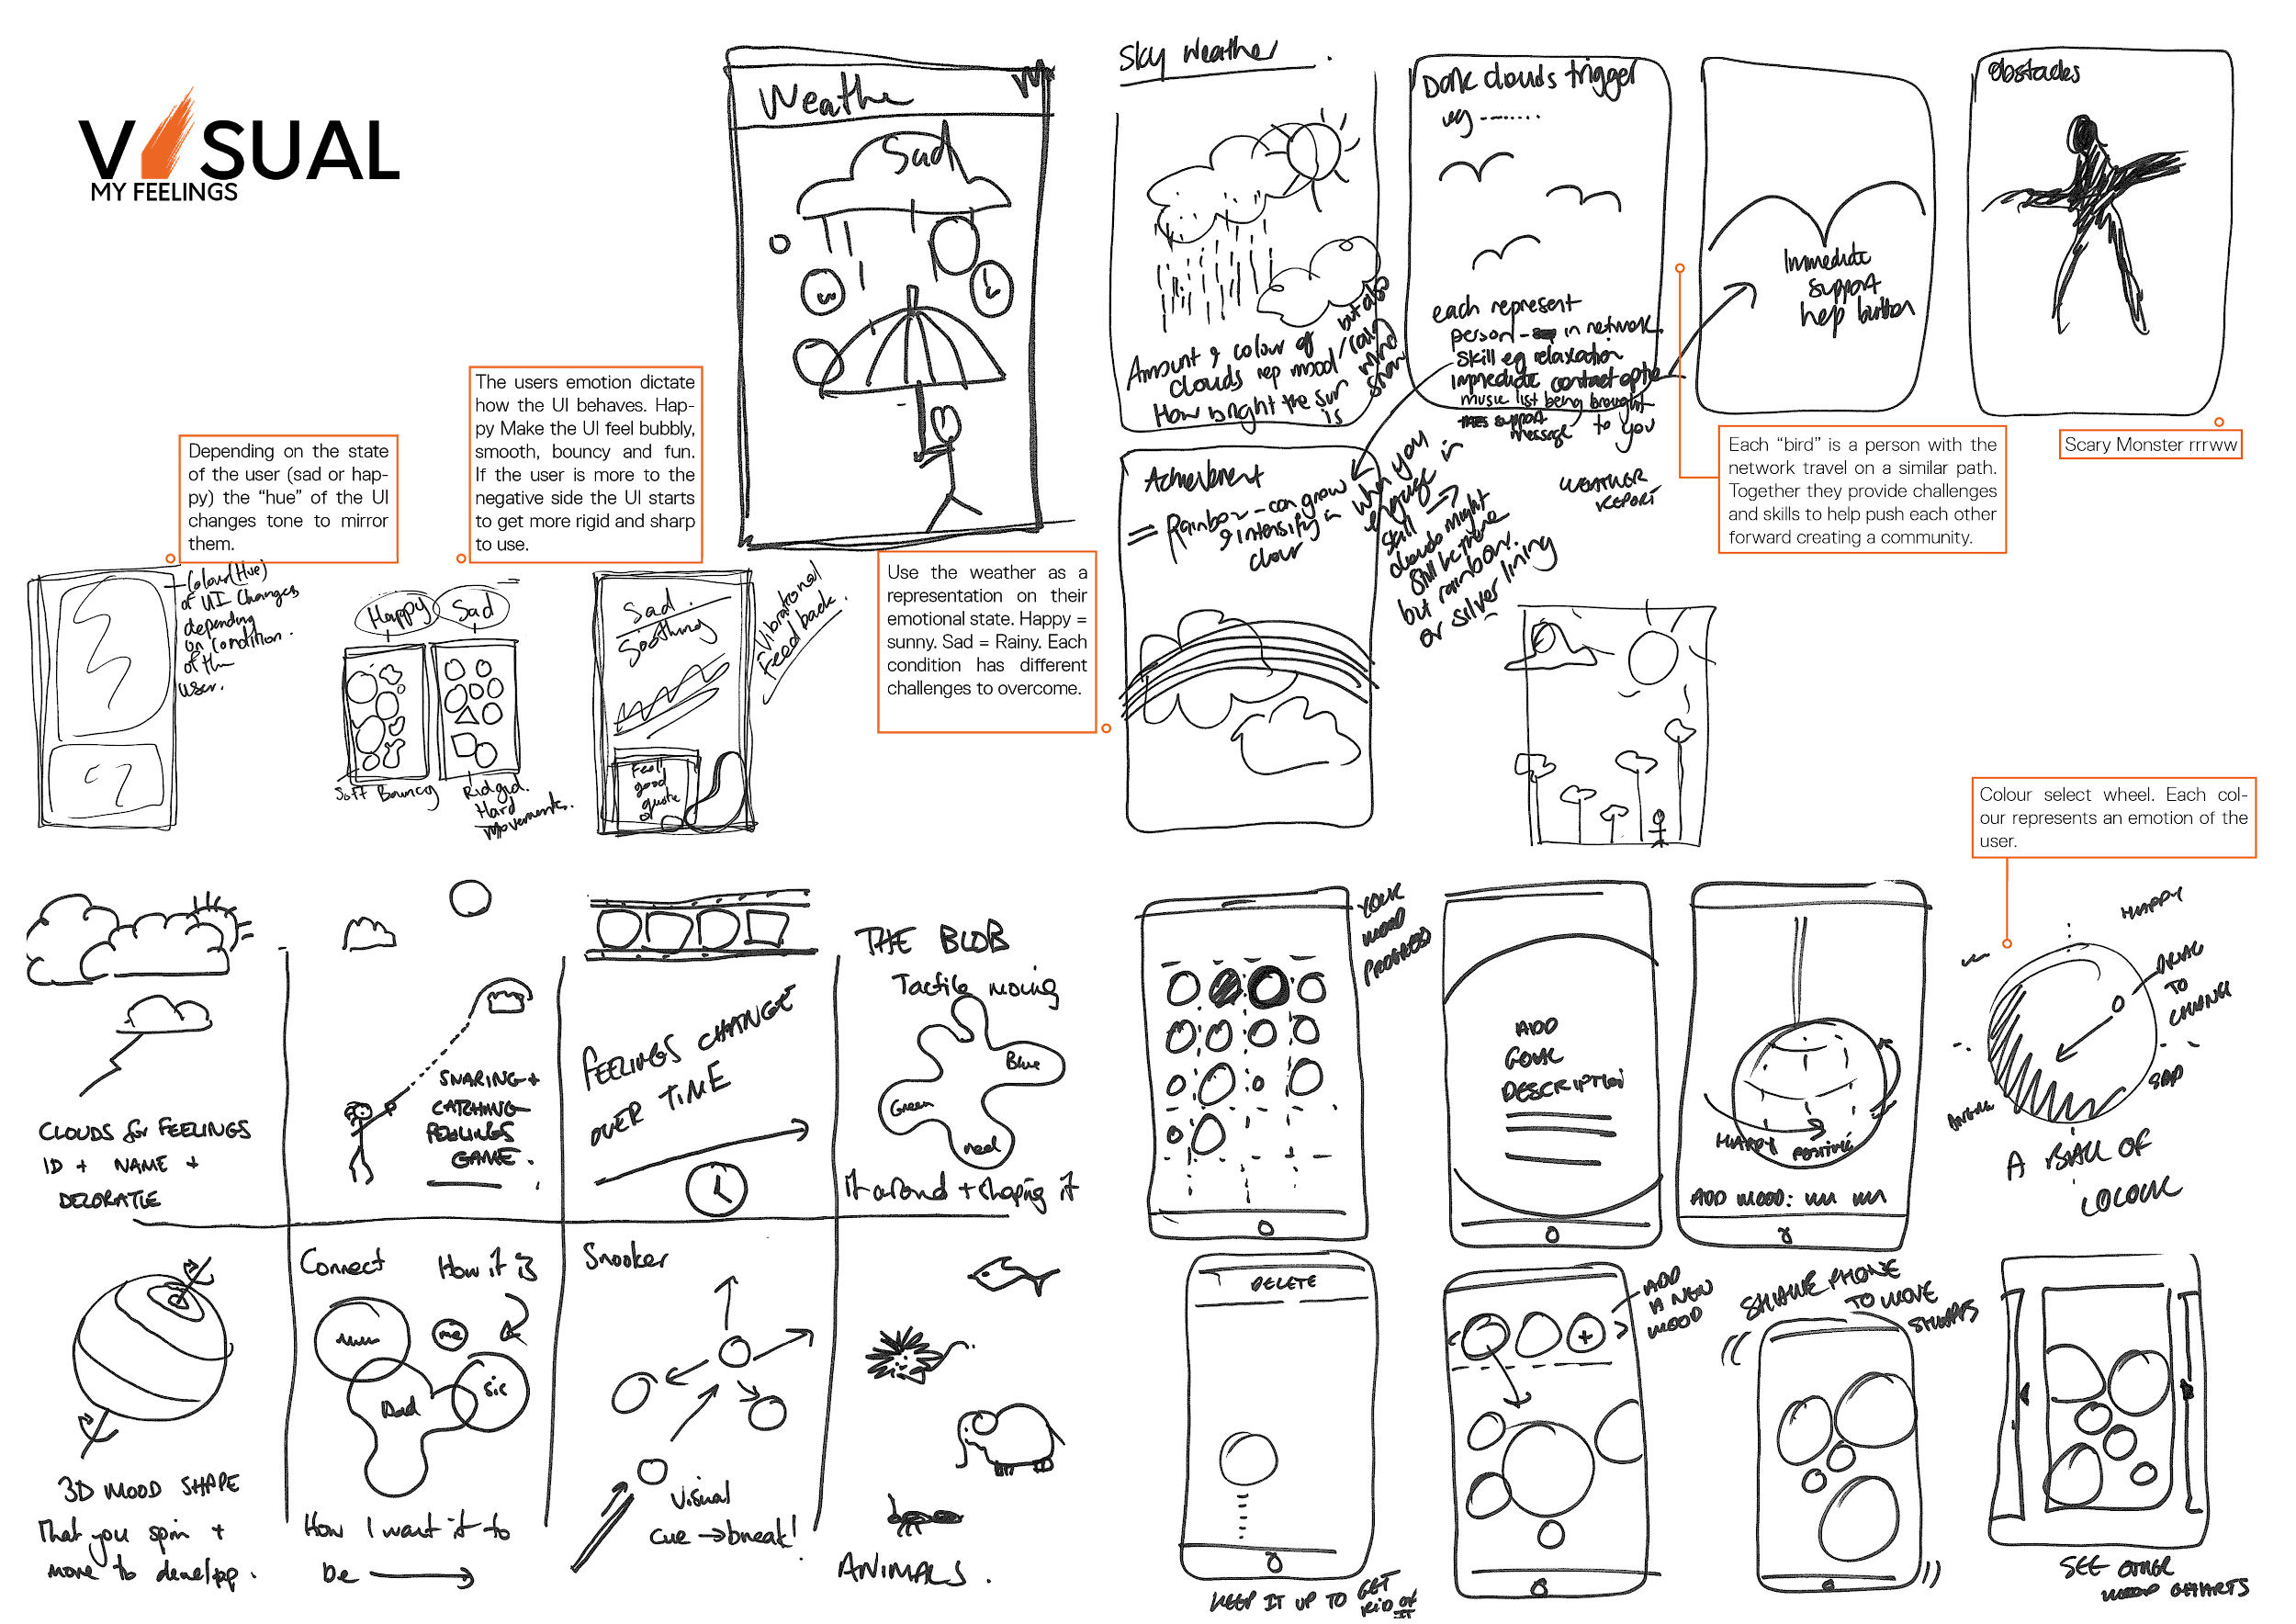
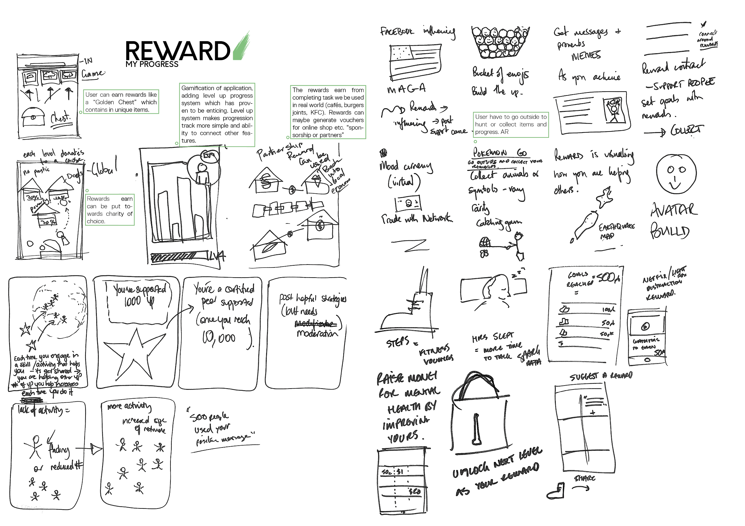
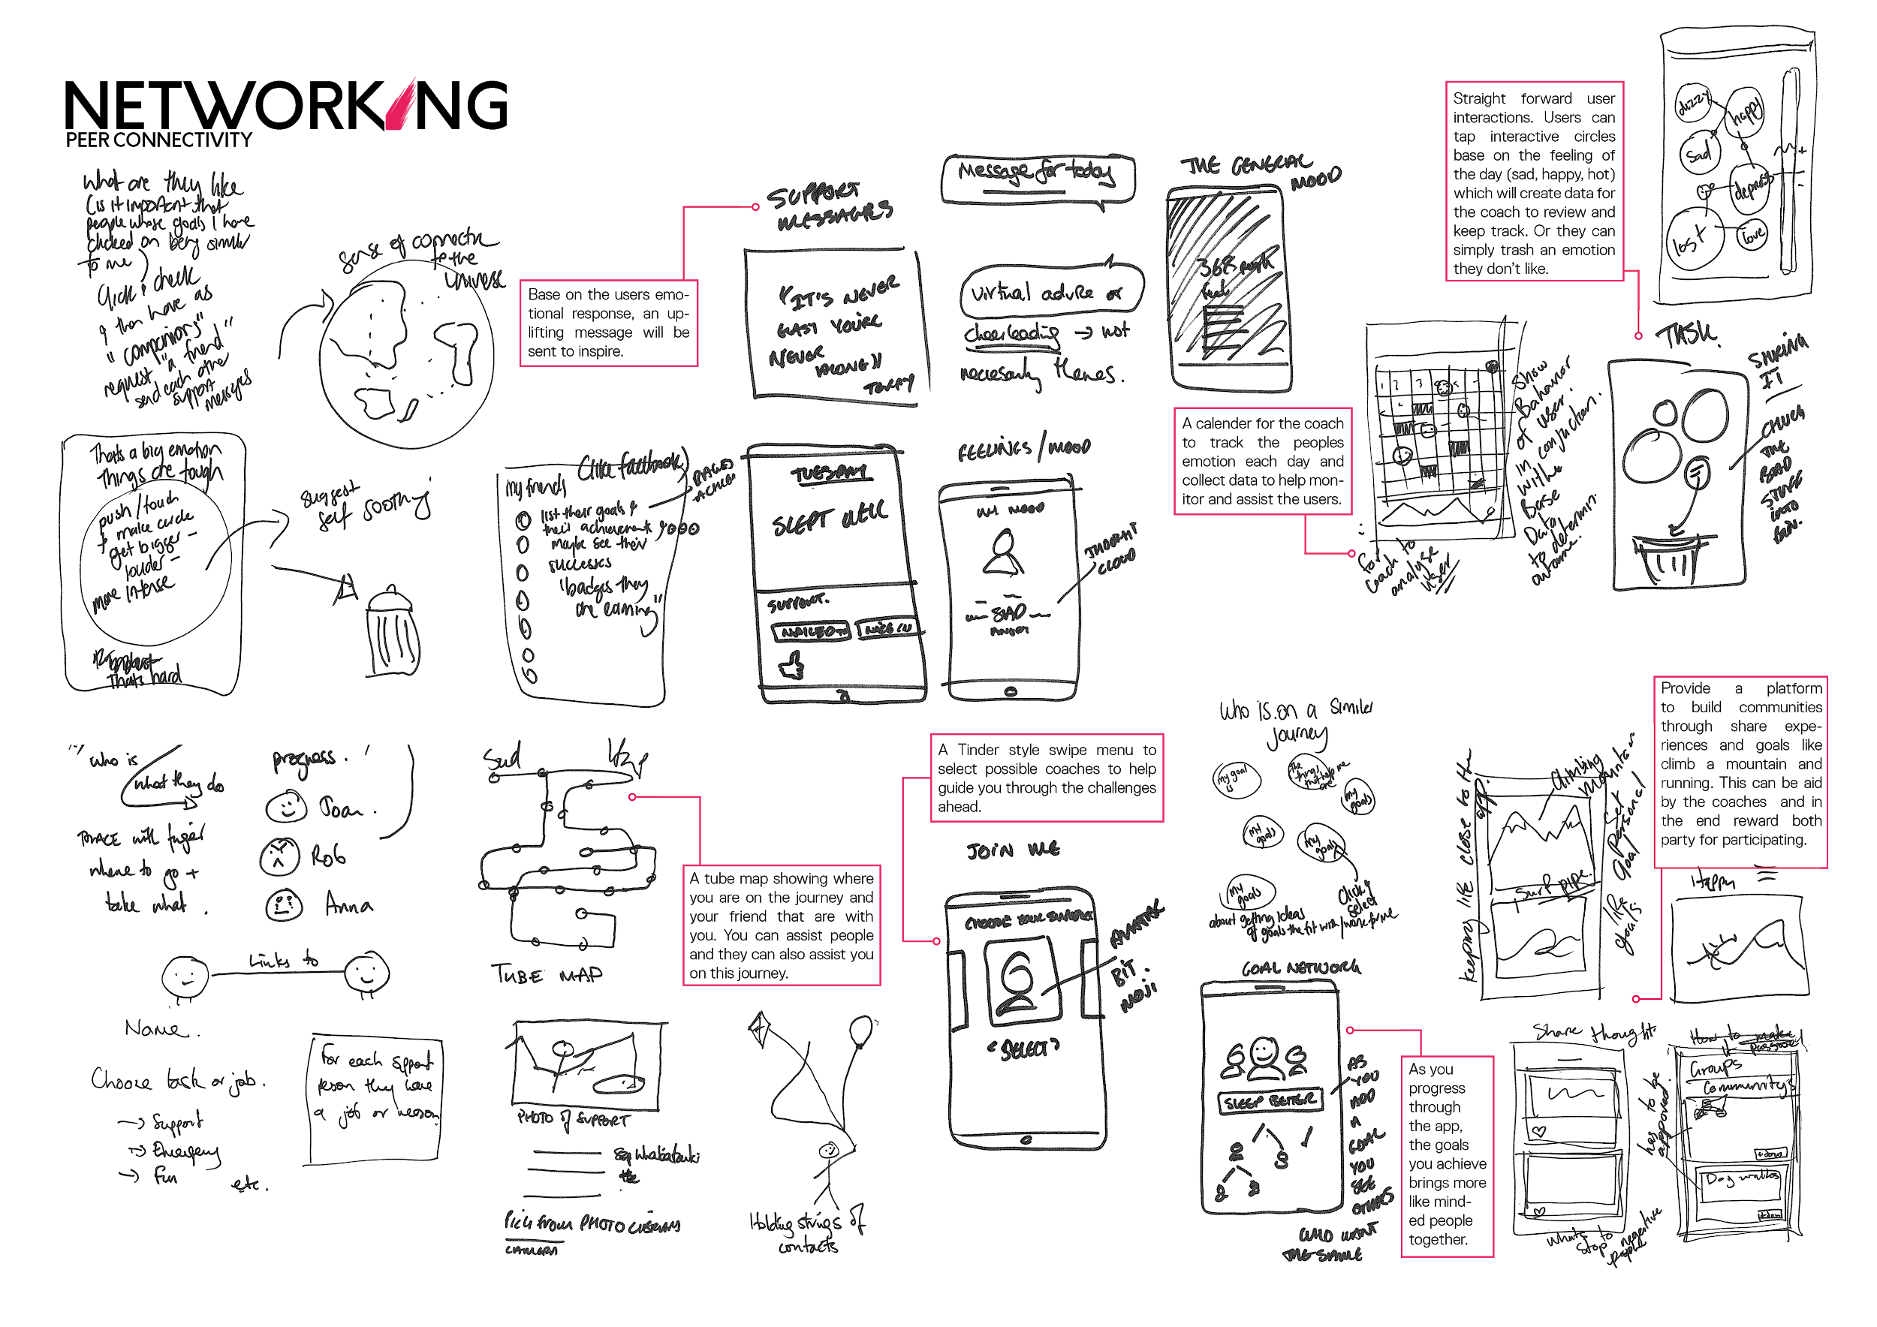
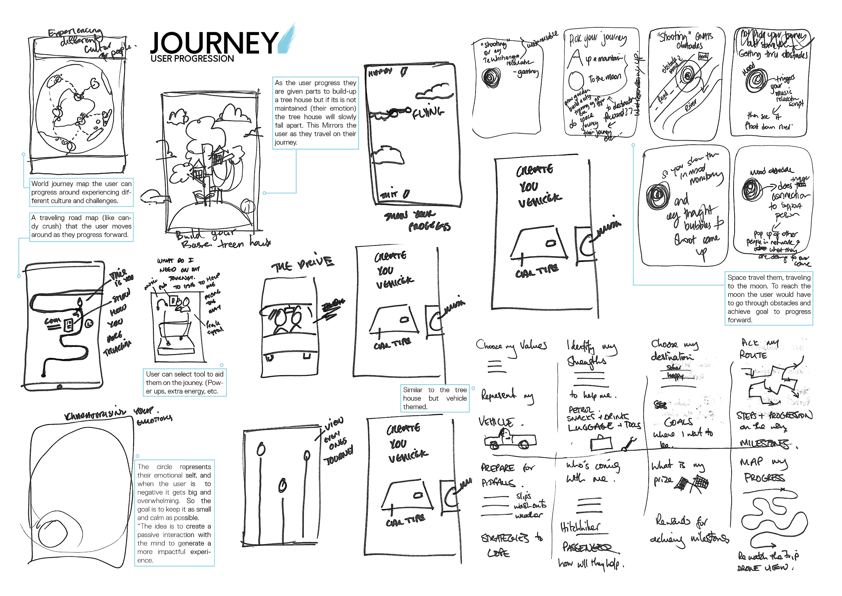
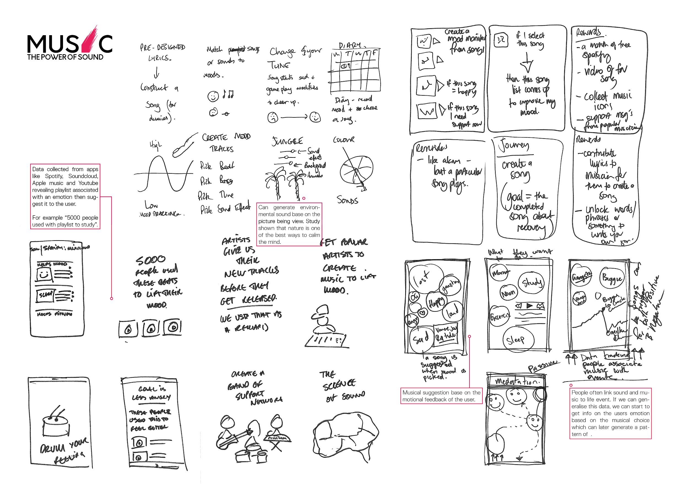
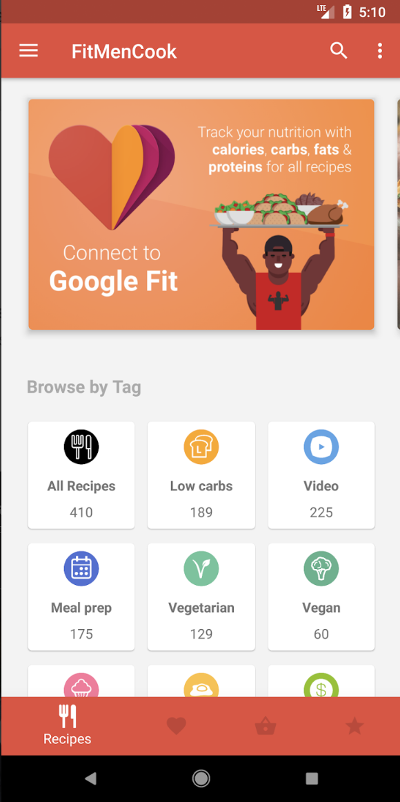
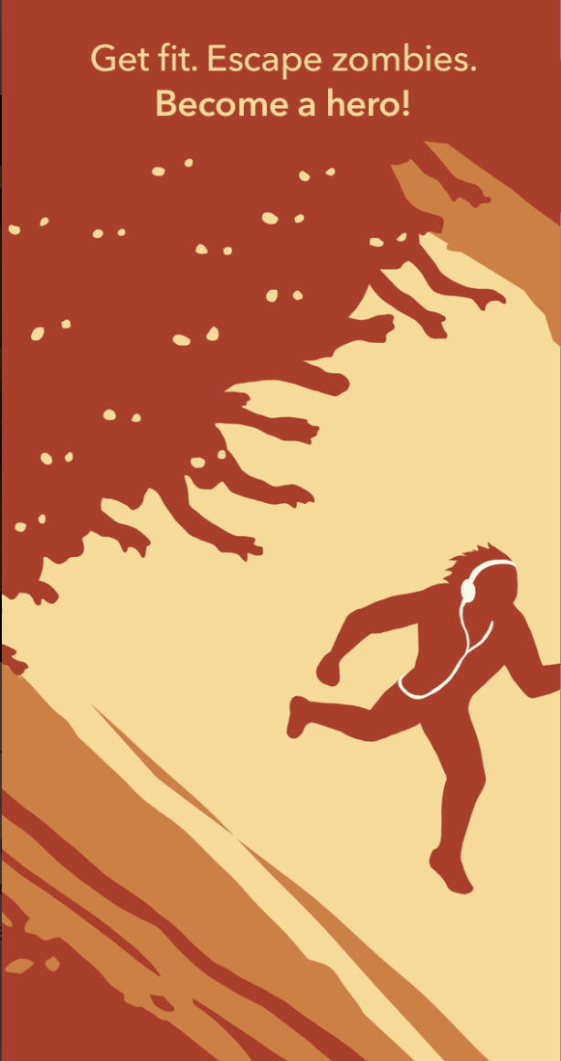
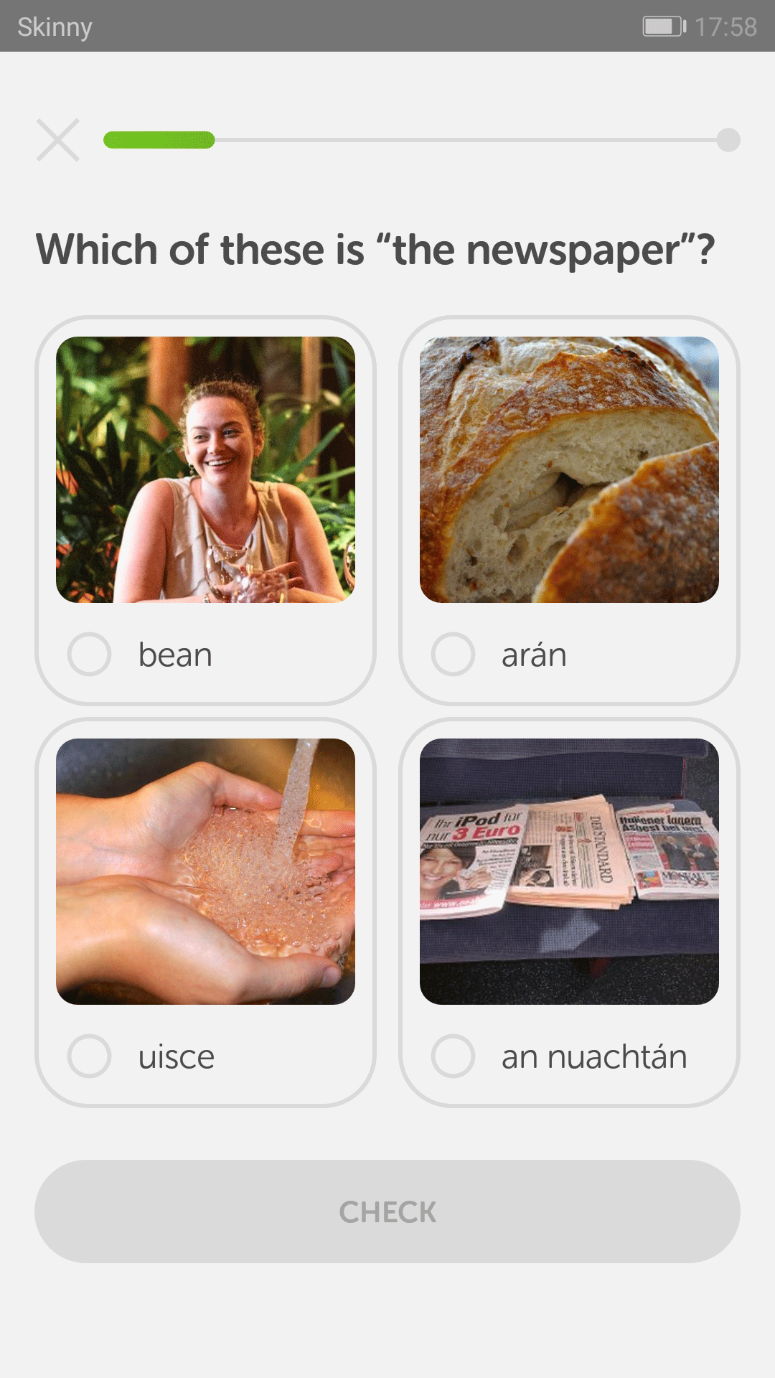
A focus on engagement
The vision
To empower young people to track & achieve positive change, through a personalised digital experience, connecting to a support network.
Ideation
Competitor review
FitMenCook Zombie Run Duolingo
Notes:
We know that there are an increasing number of e-mental health apps available and that these are effective if they are used – the key challenge is ensuring they are used.
The app developers have this as a key focus and the work has benefited enormously from their knowledge and expertise about engagement.
They have worked with us to:
Establish a clear vision: to empower young people to track and achieve positive change through a personalised digital experience, connecting to a support network
To look at other apps with a view to what works and what doesn’t
And to engage in a heap of brainstorming of ideas for the features that the app might include’

Slide 16
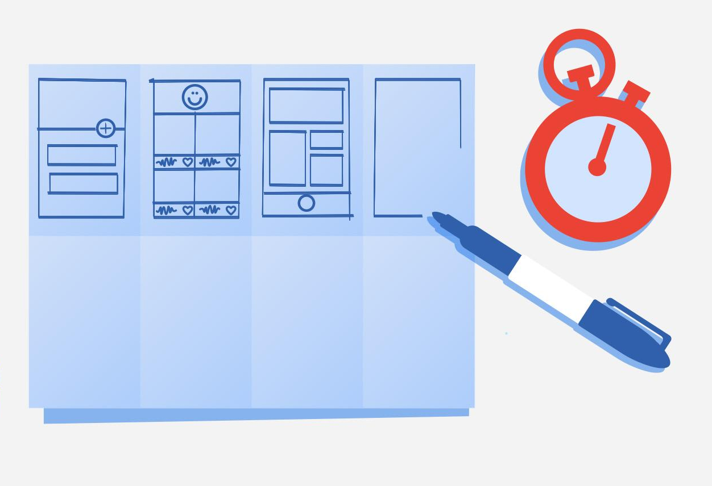
Crazy 8’s
Overview:
Crazy 8’s is a core Design Sprint method. It is a fast sketching exercise that challenges people to sketch eight distinct ideas in eight minutes. The goal is to push beyond your first idea, frequently the least innovative, and to generate a wide variety of solutions to your challenge.
Steps:
Objective:
Fold paper it into eight sections
Each team member sketches one idea in each rectangle
8 mins for the exercise
Sharing and Voting
Refine & repeat
Create your values
Set a goal
Remind me
Mood report
Acknowledge achievement
Support person

Slide 17
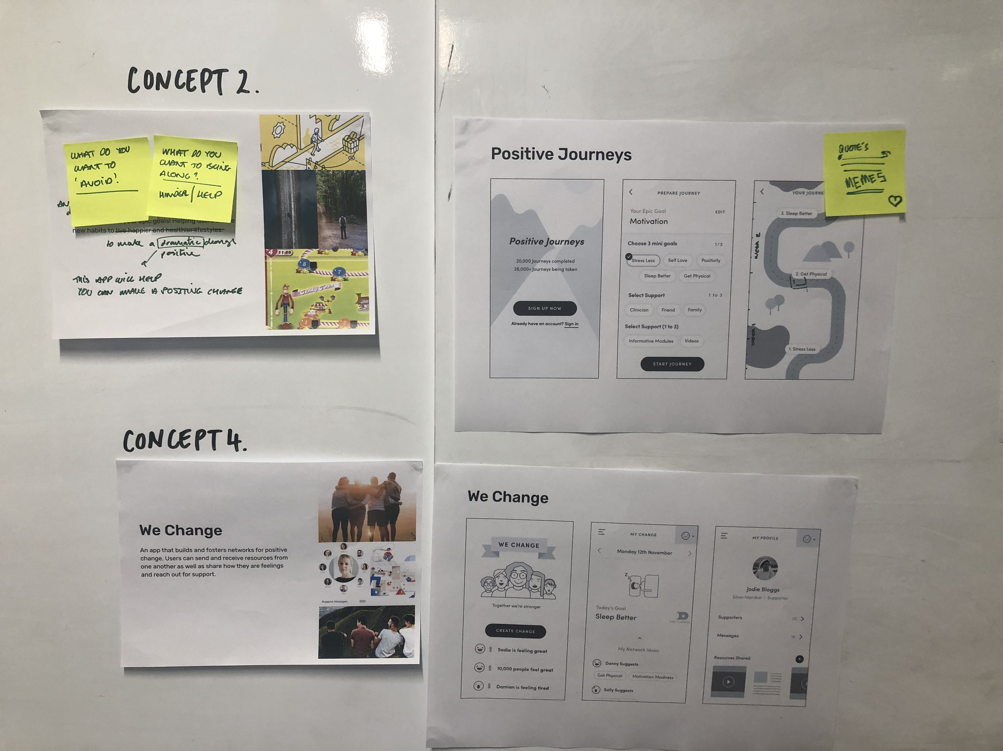
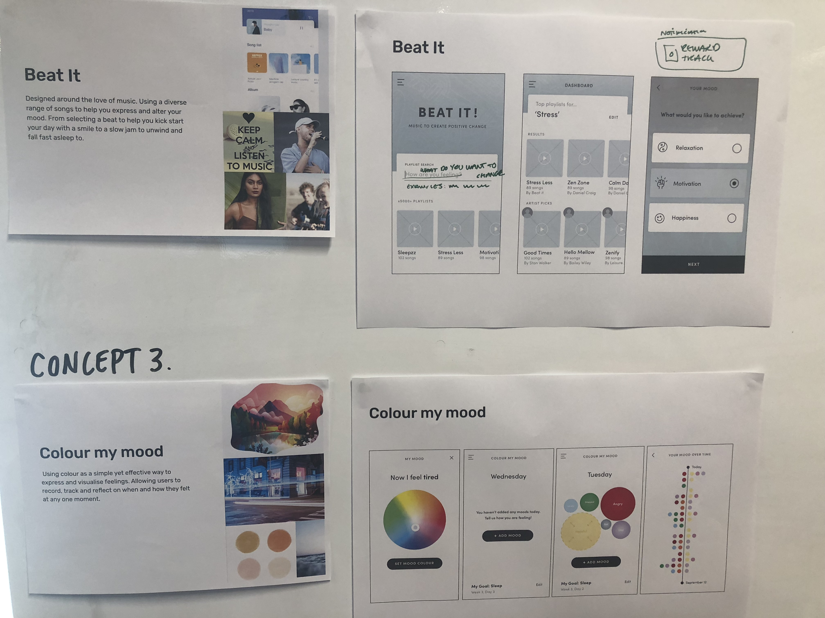
Crazy 8’s (more ideation)

Slide 18
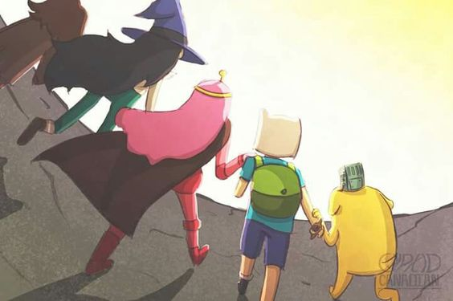
Co-design: road testing concepts
Networks
Visualising feelings
The power of music
Rewarding progress
Journeys

Slide 19
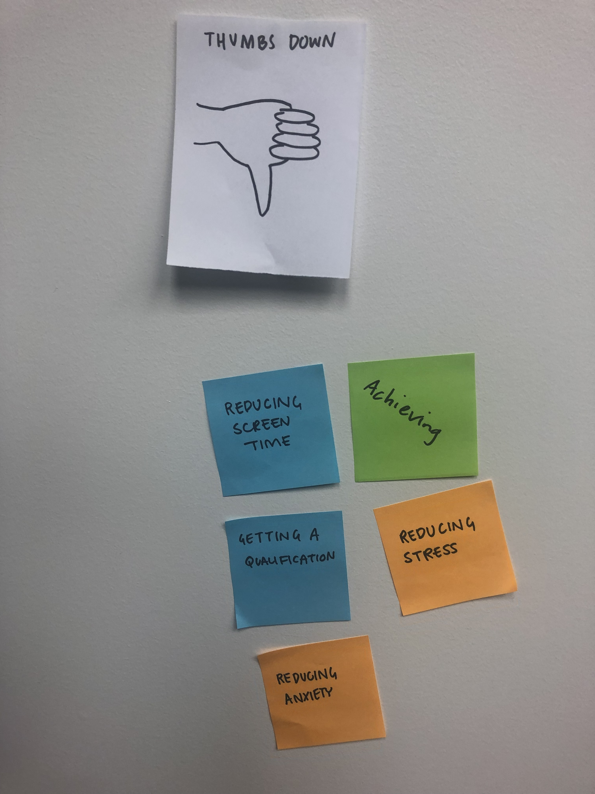
Co-designing content

Slide 20
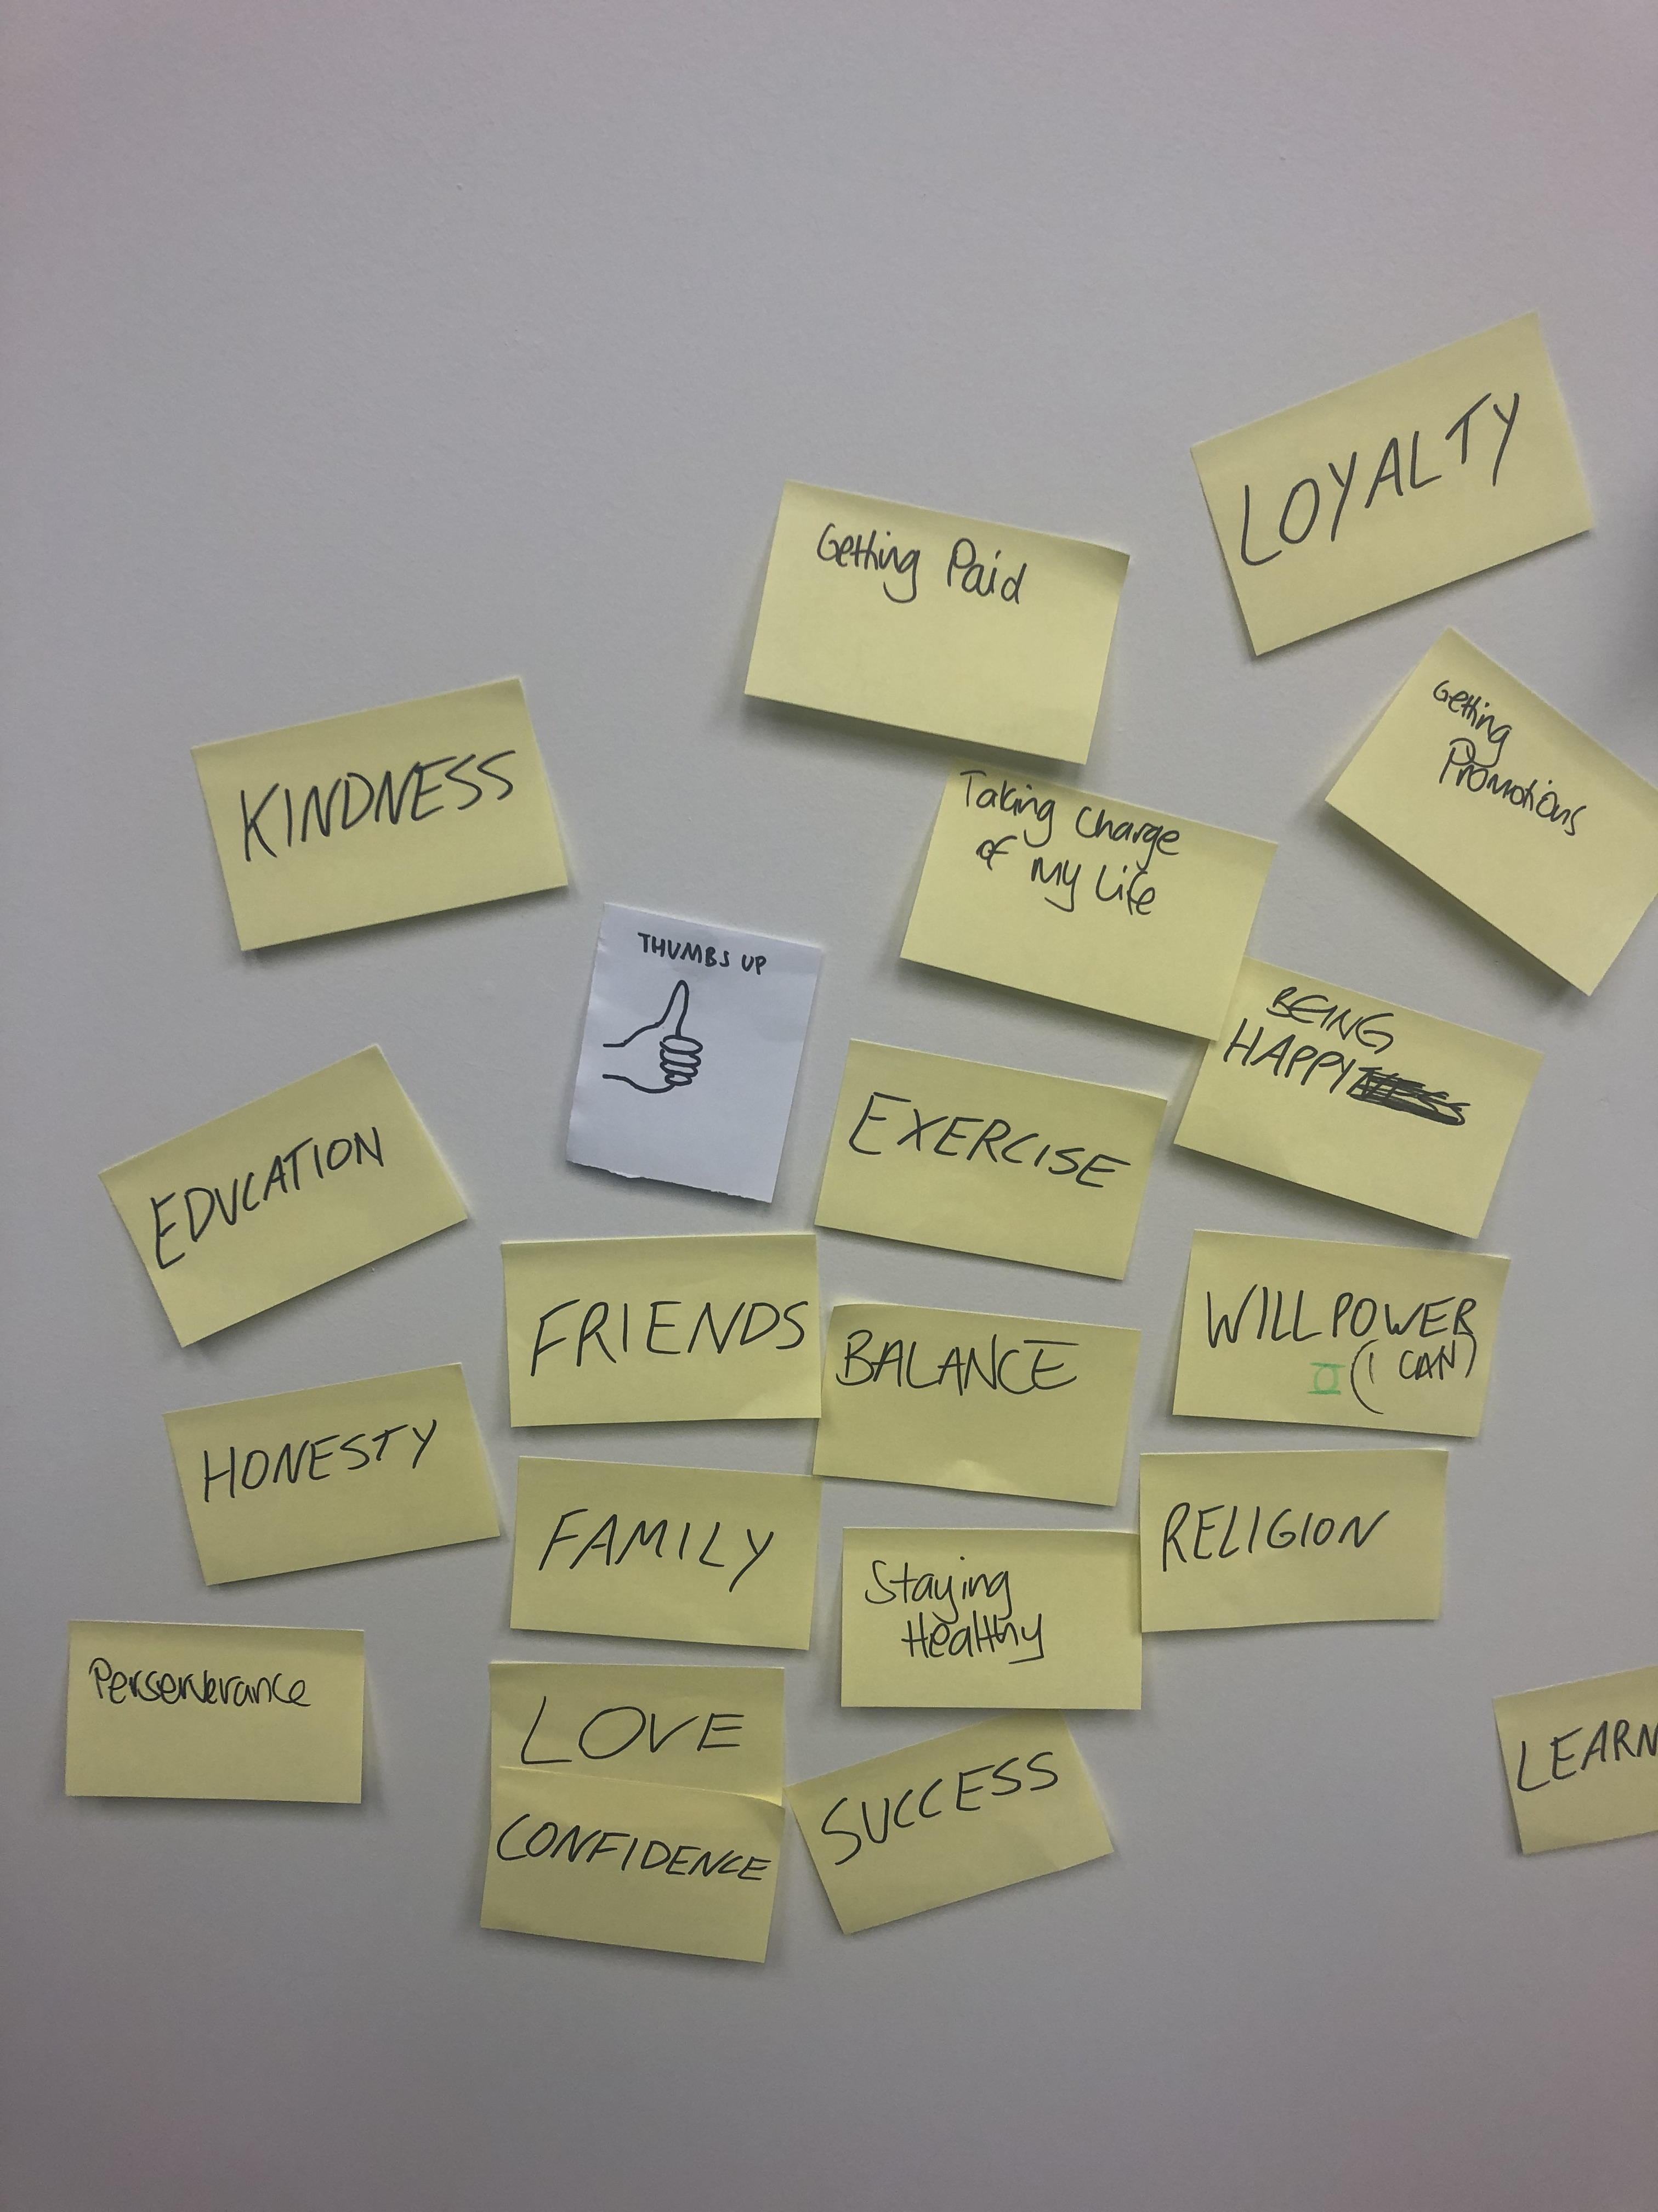
Co-designing content

Slide 21
Empowering YP to achieve positive change

Slide 22
Ehara taku toa i te toa takitahi, engari he toa takitini.
Our strength does not come from ourselves alone, our strength derives from the many
Notes:
Whakatauki; proverb

Slide 23
Acknowledgements

