Slide 1
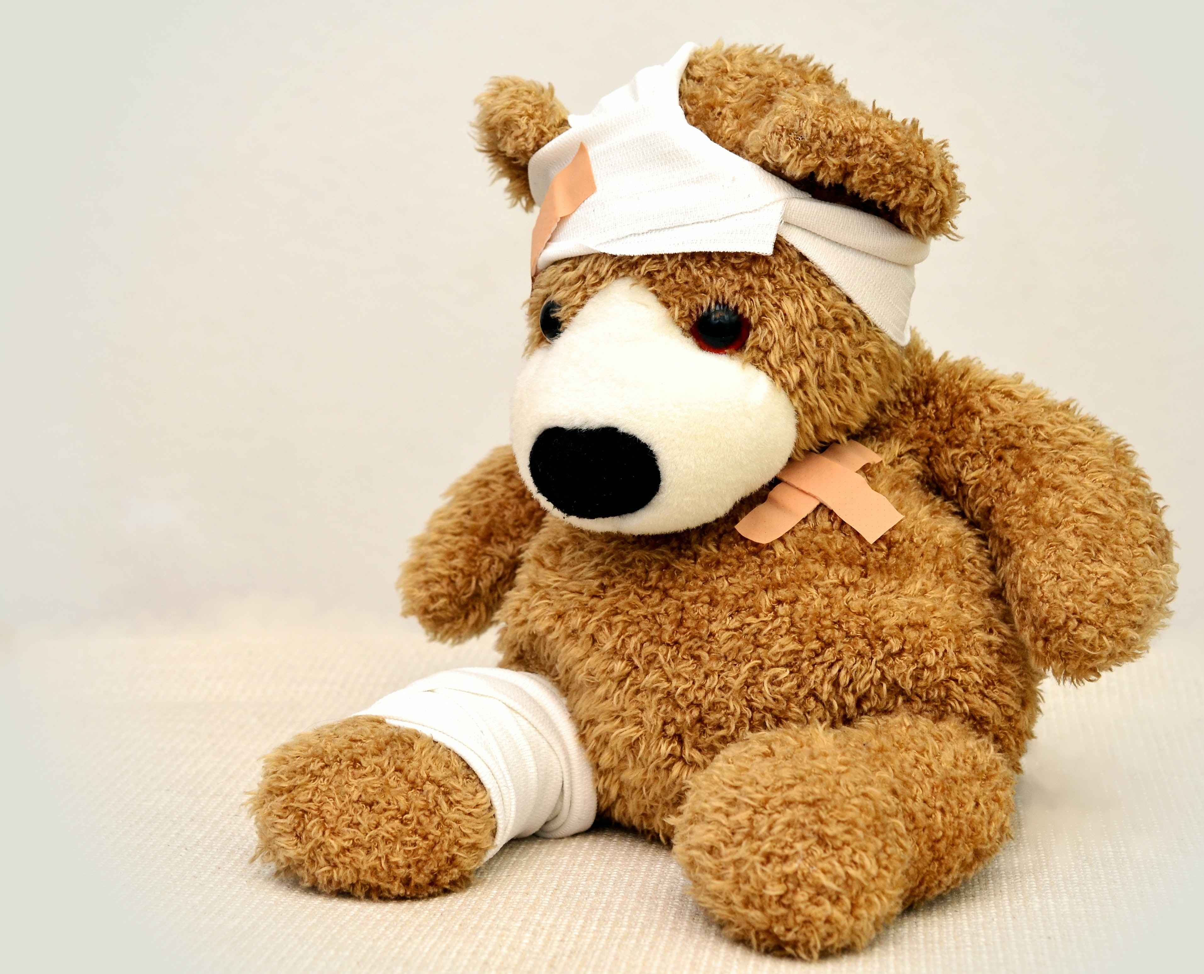
Psychological interventions for treating anxiety and depression in children with long-term physical conditions
Hiran Thabrew

Slide 2
Long-term physical conditions/chronic illness
LTPC = physical, psychological or cognitive problems lasting more than three months, which impair functioning (Van der Lee 2007)
10-12% children worldwide
Most common = asthma, diabetes, CF, and epilepsy (Eiser 1997, Burkart 2000) – unless you count obesity!

Slide 3
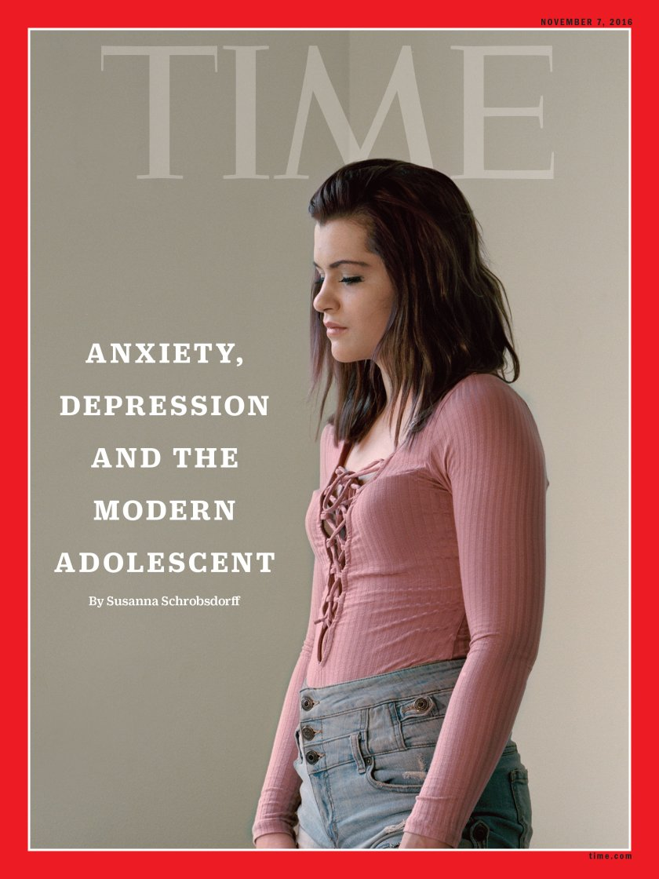
Psychological problems
Risk of psychological difficulties substantially increased in children and adolescents with LTPC (Weiland 1992, Newacheck 1991, Gortmaker 1990, Cadman 1987, Pless 1971)
Anxiety and depression most common
Up to 40% develop depression
Younger children, girls and those with some types of LTPC appear at greater risk of developing anxiety
Some types directly related to medical issues (e.g. health anxiety/procedural anxiety)
Risk related to:
Development and temperament
Environment (parenting/abuse/divorce/ poverty)
Illness & treatment (and readjustment to normal life)

Slide 4
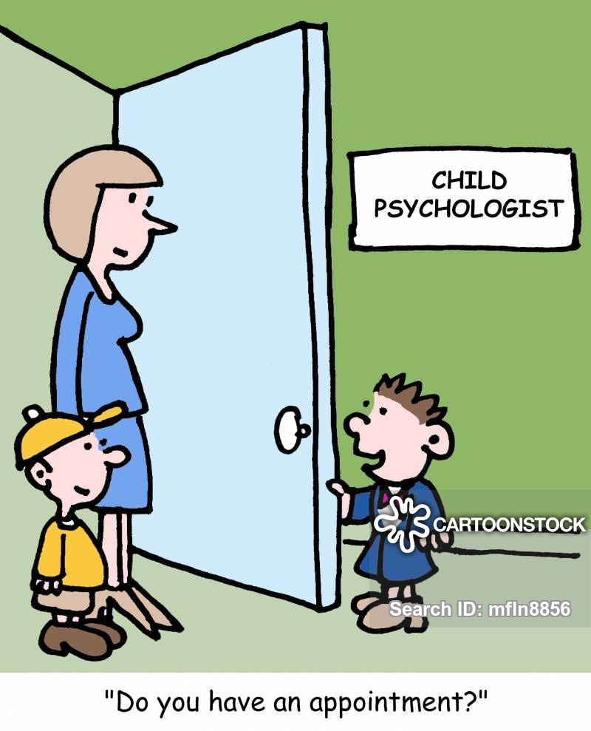
Current management
Early treatment can prevent difficulties with social and academic functioning, family issues, future mental health
Treatments offered:
Psychotherapies (talking therapies)
Medication
More recently e-health therapies
Services available:
CAMHS
NGO/PHO-based services
Consult-Liaison teams (v few!)

Slide 5
What works best?
Until recently, unclear if these therapies designed for children/adolescents without medical issues are also appropriate for those with LTPC
Systematic reviews carried out to find out
If psychological and e-health therapies are better than other therapies at reducing symptoms of anxiety and depression in this group
If they are acceptable to them

Slide 6
Review of psychological interventions
Systematic review of 29 trials including 1349 children and adolescents
Multiple databases including Medline/OVID/Psycinfo/ CINAHL/Embase
Overall ‘low to moderate’ quality of available evidence
Some short-term effect of interventions on mild symptoms of anxiety and depression if specifically designed to treat anxiety or depression (vs. other issues) and based on CBT
Limited evidence of acceptability and impact on quality of life or symptoms of LTPC
Lack of therapies for addressing health-related anxiety
Thabrew H, Stasiak K, Hetrick SE, Donkin L, Huss JH, Highlander A, Wong S, Merry SN. Psychological therapies for anxiety and depression in children and adolescents with long‐term physical conditions. Cochrane Database of Systematic Reviews. 2018(12)

Slide 7
Review of e-health interventions
Systematic review of 5 trials including 463 children and adolescents
Multiple databases including Medline/OVID/Psycinfo/ CINAHL/Embase
Overall ‘very low’ quality of available evidence, high risk of bias
None of the three therapies (Breathe Easier Online, Web-MAP and multi-modal CBT) were better than control therapies during 5 trials
Some therapies were acceptable to users
Thabrew H, Stasiak K, Hetrick SE, Wong S, Huss JH, Merry SN. E‐Health interventions for anxiety and depression in children and adolescents with long‐term physical conditions. Cochrane Database of Systematic Reviews. 2018(8)

Slide 8
Conclusions
There is currently not enough reliable evidence to help people decide which type of face-to-face or e-health therapies may be most effective for treating anxiety and depression in children and adolescents with LTPC
CBT-based therapies may be the most likely face-to-face therapies to work, but for what/whom?
The lack of effectiveness of e-health therapies contrasts with evidence of their effectiveness among children and adolescents without LTPC
There is likely to be room for new face-to-face and e-therapies, especially those targeted toward health and procedure-related anxiety. However, more rigorous testing will be required prior to widespread use

Slide 9
Thank you
Photo credits: Pixabay from Pexels
h.thabrew@auckland.ac.nz

