Slide 1
Screening for Psychosocial Issues in NZ High Schools – Is it Viable?
Hiran Thabrew

Slide 2
Psychosocial issues in NZ young people
1/3 NZ young people experience anxiety and/or depression
1/4 engage in hazardous alcohol use
Highest rate of suicide in 15-24 year age group within OECD
Limited help-seeking (stigma, limited health literacy)
Long-term personal and societal consequences

Slide 3
How do we currently address these issues?
Specialist community or inpatient mental health/AoD services: most severe (3-5%) problems
Primary health services:
NGOs/PHOs (GPs)
Private health services
School-based health services: counselling, health education, specific interventions, whole-school approaches

Slide 4
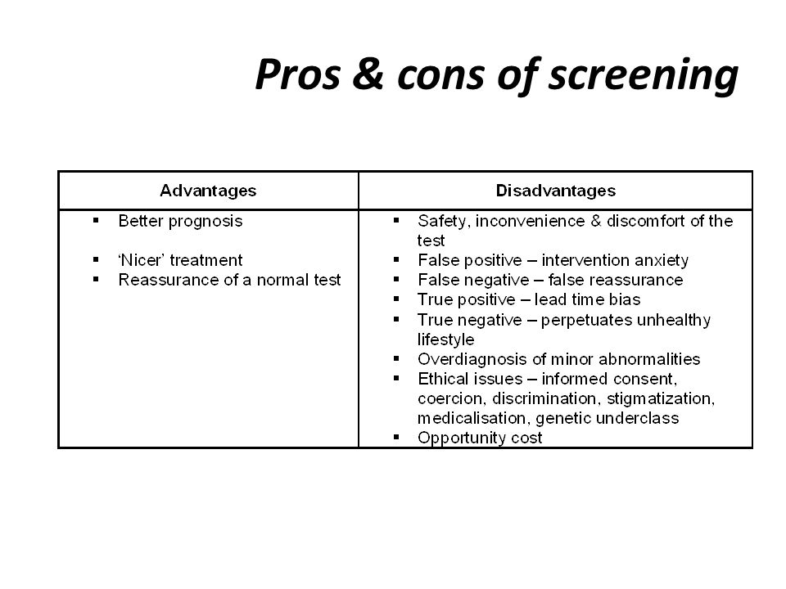
Screening
Defined by WHO as ‘the presumptive identification of unrecognized disease in an apparently healthy, asymptomatic population by means of tests, examinations or other procedures that can be applied rapidly and easily to the target population”
Pros and cons of screening

Slide 5
HEEADSSS assessment
Currently, routine screening for psychosocial issues via face-to-face HEEADSSS assessment – limited to decile 1-3 schools in NZ
Time-consuming
Expensive
HEEADSSS assessment Home: relationships, communication, anyone new? Education/Employment: ask for actual marks, hours, responsibilities Eating: body image, weight changes, dieting, exercise Activities: with peers, with family Drugs: tobacco, alcohol, other drugs – use by friends, family, self Sexuality: sexual identity, relationships, coercion, contraception, pregnancy, sexually transmitted infections (STIs) Suicide and depression: sadness, boredom, sleep patterns, anhedonia Safety: injury, seatbelt use, violence, rape, bullying, weapons Issues of ethnic identity may also be critical domains, particularly among adolescents/rangatahi from minority cultures

Slide 6
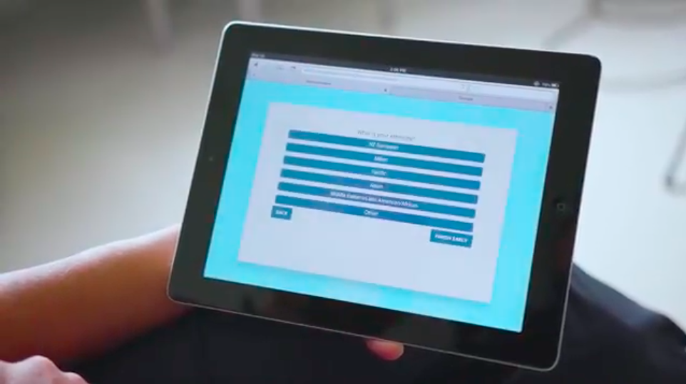
YouthCHAT
Electronic screener (ipad/tablet)
Based on CHAT/e-CHAT for adults (Felicity Goodyear-Smith et al.)
Ten domains, matching HEEADSSS assessment
Includes validated screeners for depression (PHQ-A), anxiety (GAD-7) and substance use disorders (SACS)
https://www.youtube.com/watch?v=2HHaYmfBs3g#action=share

Slide 7
YouthCHAT research to date
School-based:
Comparison with HEEADSSS assessment (2017)
Repeated screening and follow-up (2018)
(Hospital-based:
General paediatric clinic
Paediatric diabetes clinic
Adolescent/young adult cardiac clinic)

Slide 8
School-based research
RCT to validate YouthCHAT against HEEADSSS assessment with 129 Year 9 students at local high school 2017
Half students completed HEEADSSS first, half completed YouthCHAT first
Following domains evaluated:
Time taken
Effectiveness
Acceptability to students, school nurses

Slide 9
2017 study results
Participants:
63% Pacific ethnicity, 29% Māori ethnicity, 8% were of New Zealand European or other ethnicity
51% male/49% female
YouthCHAT was quick to complete:
Mean 6.35 minutes (range 3.1 - 16 minutes)
Positive feedback from young people:
6.8 (range 5-9) on a 10 point scale from “lame” to “awesome”

Slide 10
2017 study results
Positive screens
 | YouthCHAT | HEEADSSS
Substance misuse | 9.1% | 9.1%
Concerns about eating/weight* | 63.6% | 22.7%
Mental health/distress* | 10% | 27.2%
Problems at home | 27.3% | 26.3%
Sexual health concerns* | 21.8% | 9.1%
Safety concerns* | 59.1% | 15.4%
Physical inactivity* | 39.1% | 19.1%

Slide 11
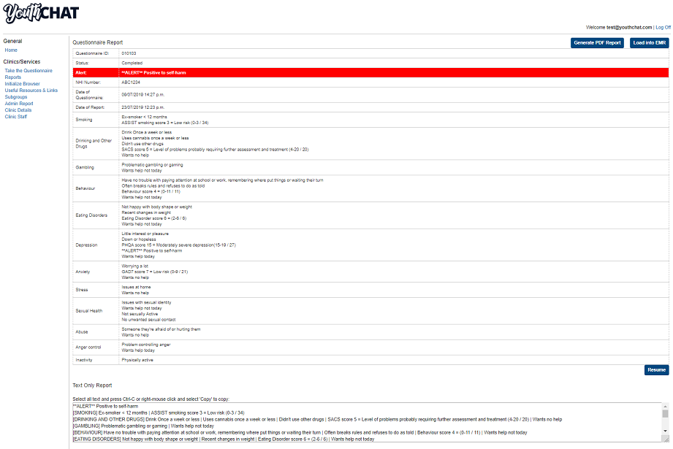
2017 study results
Feedback from school nurses:
1. Valuable tool
“Most of the kids were able to answer the questions easily” N2
“I really liked the clinical summary at the end of YouthCHAT. Other staff members (e.g., counsellors) thought it was useful as well N1
“I love the fact that it asks ‘Do you want help today… or in the future’ – we all know that nobody is going to change unless they want to, so it’s a good way of saving my time and theirs” N2

Slide 12
2017 study results
2.Difficulties with use
We had some issues with connectivity” N1
“Literacy issues – those are the kinds of kids that give up early” N3
3. Comparing YouthCHAT with HEEADSSS
“For me to do a HEEADSSS, it takes so long and then to write it up, whereas YouthCHAT is so quick” N2
“I think it’s better to give YouthCHAT first before talking with them face to face as it gets them in the groove, gives them time to get used to answering questions” N2
4. Additional uses for YouthCHAT
“I’d really like the rest of the school health team (counsellors, social workers, nurses, psychologist, addiction workers, GP) to be able to administer YouthCHAT, not just school nurses” N2
“Be good to ….follow up with them the next year.” N1

Slide 13
2018 study results
Participants:
63% Pacific, 29% Maori, 8% other,
50% male, 48% female, 2% gender diverse
Mean time to complete YouthCHAT:
6 minutes and 32 seconds (range 2.13 minutes to 16.45 minutes)
YouthCHAT remained acceptable to students:
Mean helpfulness rating 7.3 (3-10)
Overall, similar rates of issues detected in 2017 and 2018 except:
Perceived life stress (down, p=0.04) Depression (up, p=0.002) Substance misuse (up, p=0.07)
YouthCHAT domain | Remained positive in 2018 (% of those positive in 2017) | New positive cases in 2018 (% of those not positive in 2017)
 | n (%) | n (%)
Smoking | 6 (67) | 7 (7)
Drinking | 3 (60) | 7 (8)
Drugs | 5 (83) | 7 (8)
Eating Disorder | 92 (99) | 2 (2)
Depression | 5 (42) | 25 (26)
Self-harm | 2 (33) | 3 (3)
Anxiety | 8 (40) | 11 (12)
Stress | 9 (31) | 8 (9)
Behaviour | 36 (68) | 12 (13)
Sexual Health | 9 (43) | 7 (8)
Abuse | 5 (26) | 7 (8)
Anger | 19 (58) | 13 (15)
Physical inactivity | 17 (46) | 9 (10)

Slide 14
2018 study results
Follow-up primarily to school-based services, not external services
 | No follow-up required n (%) | Referrals to internal school staff |  |  | Referrals to external agencies and programmes
 |  | Nurse N (%) | Counsellor N (%) | Social worker N (%) | N (%) | Type of referral
Depression | 100 (88) | 1 (1) | 13 (12) |  | 2 (2) | Specialist mental health service
Self-harm | 104 (92) | 1 (1) | 9 (8)
Anxiety | 97 (86) |  | 16 (14)
Substance misuse | 96 (85) | 1 (1) | 8 (7) |  | 11 (10) | Addictions programme
Sexual health | 89 (79) | 11 (10) | 17 (15)
Eating/ exercise | 95 (84) | 1 (1) | 3 (2.6) |  | 15 (13) | Fitness programme
Behaviour concerns | 95 (84) |  | 17 (15) |  | 1 (1) | Behaviour support service
Safety | 77 (68) | 1 (1) | 34 (30) |  | 2 (2) | Anger management counselling agency
Stress | 85 (75) |  | 21 (19) | 11 (10)

Slide 15
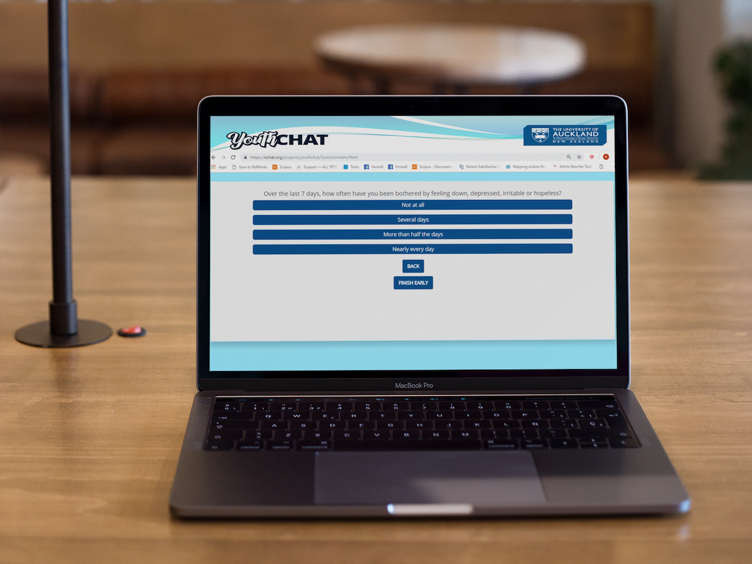
What next?
YouthCHAT is a viable screener for use in NZ high schools – quick, cheap and acceptable to users
Further research is needed to evaluate rates of identified issues in other years (years 11-13; 15-18 year olds) and in different types of school settings
Routine screening may provide a way to evaluate the effectiveness of (especially school-based) preventative and/or therapeutic interventions

Slide 16
Thank you
Photo credits: Tophee Marquez, Kat Jayne, Rebcentre Moscow, 周 康
Fauxels from Pexels
h.thabrew@auckland.ac.nz

